Slide 1


Python
GRADE 7 & 8
Lesson 01

Slide 2






CLASS RULES
Stay Seen
Focus Zone
Keep your camera on, stay connected!
Keep backgrounds and actions distraction free.
Mic Manners
Laptop & Wi-Fi Ready
Mute unless it’s your turn to talk.
Strong connection, smooth learning.
Hands Up
Login & Go
Use the virtual hand to speak up.
Have all platforms and passwords handy.

Slide 3
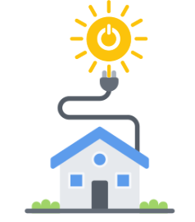
ICE BREAKER
"I capture sunlight to make power each day.
My output depends on how long the sun stays, where I’m placed, and the angle I face.
What am I, and what helps you calculate my energy?”
Notes:
Answer: Solar Panel, solar cell

Slide 4
Learning Outcome
Learn about history of Python, features and applications of Python
Explore the Python online IDE – Google Colab
Explore and work with various Python data types.
Understand how to declare and manage variables.
Learn to perform type conversion between different data formats.
Gain skills in using input and output functions for program interaction.
Let’s unlock the potential of Python, one step at a time!
Notes:
Learning Outcome: Develop an innovative Python program that calculates the daily power production of a single solar panel, allowing users to easily estimate energy generation based on factors like sunlight hours and panel efficiency.

Slide 5

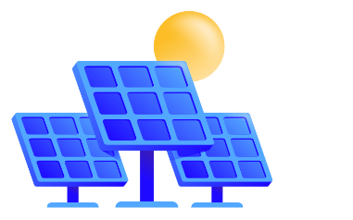
PROBLEM STATEMENT
Imagine you're a super-powered solar panel!
Your job is to harness the sun's energy and turn it into electricity.
To do this, you need to calculate how much power you generate each day.
Your Mission:
Create a Python program to calculate the daily power output of a solar panel using factors like sunlight hours and panel efficiency.
Notes:
Student Task: To create a Python program to calculate the daily power output for 1 solar panel for summer and winter seasons separately.

Slide 6

History of Python
1989: Created by Guido van Rossum at CWI, inspired by the ABC language.
1991: First release (Python 0.9.0) with functions, exception handling, and core data types.
1994: Python 1.0 introduced modules, classes, and file handling.
2000: Python 2.0 added list comprehensions and garbage collection.
2008: Python 3.0 launched with better Unicode support and modern syntax.
Today: Widely used in web development, data science, AI, and automation.
Founded by Guido van Rossum 1991
Notes:
Interesting Fact: Known for its simplicity and versatility, Python is one of the most popular programming languages globally!

Slide 7
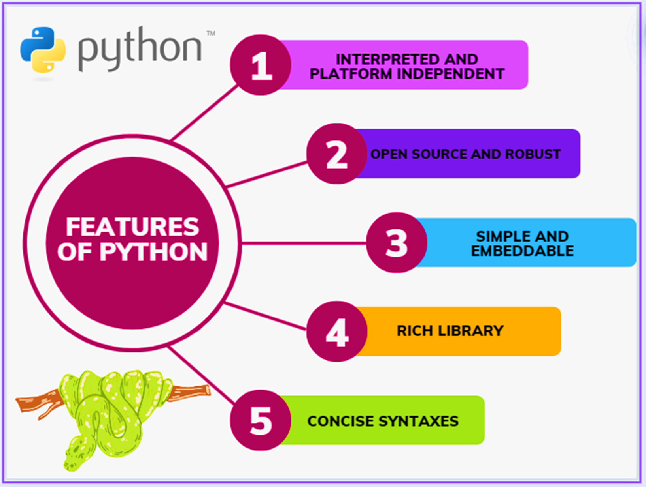
Features of Python
Notes:
The common features of python are :
It is an interpreted and platform independent language. Interpreted means it doesn't require a compiler to run it's programs and executes the programs line by line.
Platform independent means it can run on different operating systems like windows, Linux, mac etc.
It is open source means free of cost and robust. It is simple and embeddable syntax are very simple and concise .
It can be embedded inside web application, GUI based applications, software applications, etc.
It has rich libraries of inbuilt functions to perform mathematical, logarithmic operations , data science apps, machine learning and AI applications, and operating system libraries as well.

Slide 8
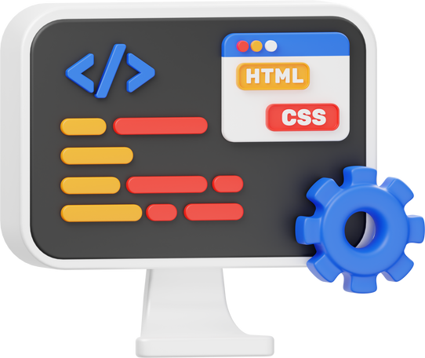




Applications of Python
Web Development
Software Applications
GUI Applications and widgets
Machine learning and AI
Big Data handling
Notes:
Teacher Notes:
Various applications of python include web development, software applications GUI applications big data handling, machine.
For all these applications python has a rich set of inbuilt functions called as libraries.
Real-time Applications:
Instagram: Uses Python for scalability, allowing the platform to quickly roll out new features
Dropbox: Uses Python on both the server and client sides, allowing for quick implementation, testing, and deployment of new features
Spotify: Uses Python for its increased development speed and enhanced analytics
Netflix: Uses Python-based apps to manage the majority of their network devices

Slide 9


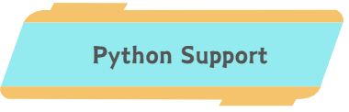



Google Colab
Notes:
Platform Introduction:
Google Colab (short for Collaboratory) is a free, cloud-based platform provided by Google that allows users to write, run, and share Python code through Jupyter Notebook-like interfaces. It's particularly popular for data science, machine learning, and general Python programming because it provides access to free GPUs and TPUs for computation.
Key Features:
Free to Use: Anyone with a Google account can use it at no cost.
Integration with Google Drive: Easily save and share notebooks.
Python Support: Designed specifically for Python programming.
Rich Visualization: Supports popular Python libraries like Matplotlib, Seaborn, and Plotly.
Cloud-Based: No installation required; everything runs in your web browser.
Collaboration: Multiple users can work on the same notebook in real-time, similar to Google Docs.

Slide 10
Variables
A Variable is a placeholder
Ex. Name=“John”
score=120
age=12.5
Variables can store various types of values, such as numeric, text, floating-point (decimal), and complex numbers.
We can even manipulate the values of a variable- score can be increased or decreased
Python helps to store multiple values in one variable too. Ex. List
Notes:
Let us now learn about variables.
Variables can hold different types of values it can hold numeric values or text-based values
Even sometimes multiple values can be stored in one variable
We can even manipulate the values of variables for examples score can be increased or decreased
Similarly, the values of the variables can be increased or decrease or changed.

Slide 11



Examples of Variables
Money Bag - Placeholder
Amount of money - value
Glass or Jug - Placeholder
Amount of juice - value
Basket - Placeholder
Number of fruits - value
Notes:
Teacher notes:
The amount of value can be increased or decreased.
Ask Students:
To share more real-life examples like an ink pen, water bottle, etc

Slide 12
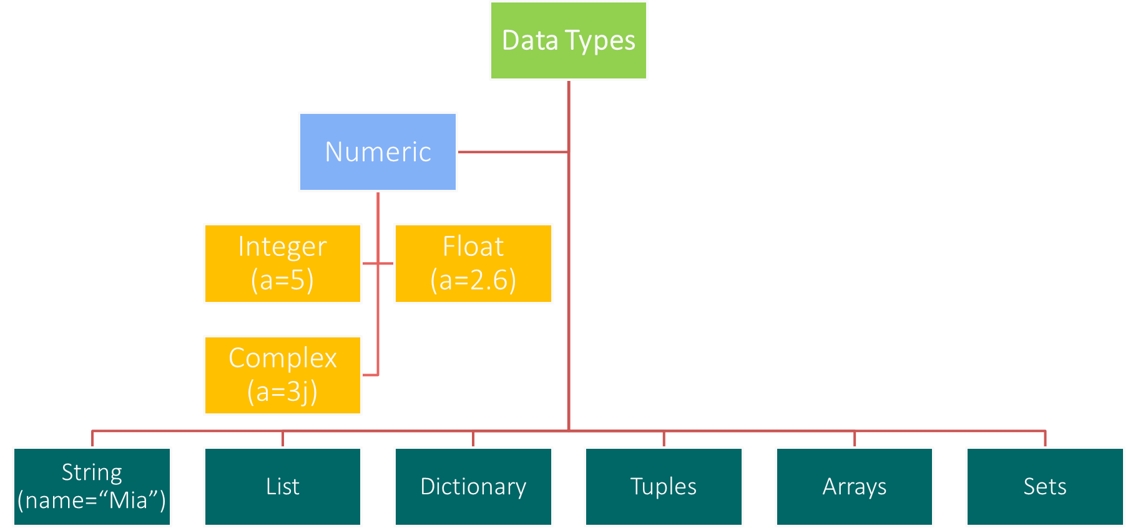
Data Types
Notes:
Teacher Notes:
Python supports the number of data types out of which we are going to see some numeric data types in some recent classes. Numeric data types supported by Python are integer, float which stores decimal values and complex data types which store complex numbers.
Other data types are string data types which stores text-based values.
These data types support single value inside one variable.
While list, dictionary, tuples, arrays, sets hold multiple values inside a single variable.
Just for Teacher Reference:
(Do not introduce now)
Ex. List = [“John”,”Peter”,”Alice”]

Slide 13
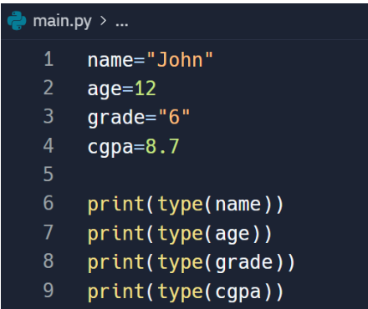
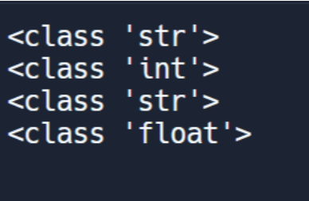
Practical Example
Variables holding different types of data:
Integer, float, string
type() function to display the data type
Output of the print statements
Notes:
Teacher Led Example:
These are code snippets where we have implemented variables.
Here name, age, grade and CGPA are the names of the variables while John ,12, 6, and 8.7 are values of the variables.
Type function returns type of data the variable name holds.
Ask Students:
What will be the data-type of profit made by your business in a year?
What will be the data-type of your house address?

Slide 14
Main Activity
Let's say you have a 300-watt solar panel that receives an average of 5 hours of direct sunlight per day. To calculate the daily output in W (watt), we would use the following formula:
Daily Output (W) = Wattage (W) x Hours of Sunlight x Efficiency
(Where wattage is the watt production capacity of one solar panel).
In this case, it would be:
Daily Output (W) = 300 W x 5 hours x 0.2 (assuming a 20% efficiency) = 300 w
Notes:
Teacher Reference:
Explain how to calculate the wattage.
Typical Efficiency Values: Most solar panels have an efficiency between 15% and 22%, depending on their technology (e.g., monocrystalline, polycrystalline, or thin-film) and material.
Let's consider the Efficiency as 20%. (Hence 0.2 is considered here as a constant)

Slide 15
Algorithm
Take user input:
How many hours of sunlight do you get each day?
Calculate Power Output:
Use a formula to calculate the daily wattage based on sun hours and efficiency.
Display the Result:
Print a message like, "Today, I generated [wattage] watts of power! I’m powering the world, one watt at a time!"
Notes:
Here's what you need to know:
Solar Power: The amount of power you generate depends on how sunny it is.
Sun Hours: You'll need to know how many hours of sunlight you get each day.
Panel Efficiency: Your efficiency rating tells you how well you convert sunlight into electricity.
Probing Questions:
Can you make your program work for different types of solar panels with different efficiency ratings?
Can you add a feature to estimate monthly or yearly power output?

Slide 16
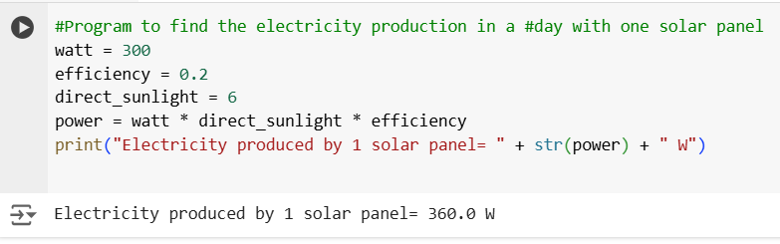
Implementation
print (
“Electricity produced by 1 solar panel= ”
+
str (power)
+
“W”
)
Preceding sentence for the result
Used for concatenating 2 strings
Print the unit
Type conversion
https://colab.research.google.com/drive/14kSF__uow49DFbwY0Ng7UPUocxSdu3Sc?usp=sharing
Notes:
Teacher Reference:
Explain the code in colab.
Type conversion:
In print statement, if you concatenate (join) two variables using a ‘+’ sign, you need to make sure that both should be of same type.
If they are not of the same type, then you need to convert their type.
str() – converts to string type. Ex. str (power)
float() – converts to float type. Ex. float (power)
int()- converts to integer type. Ex. int (power)

Slide 17
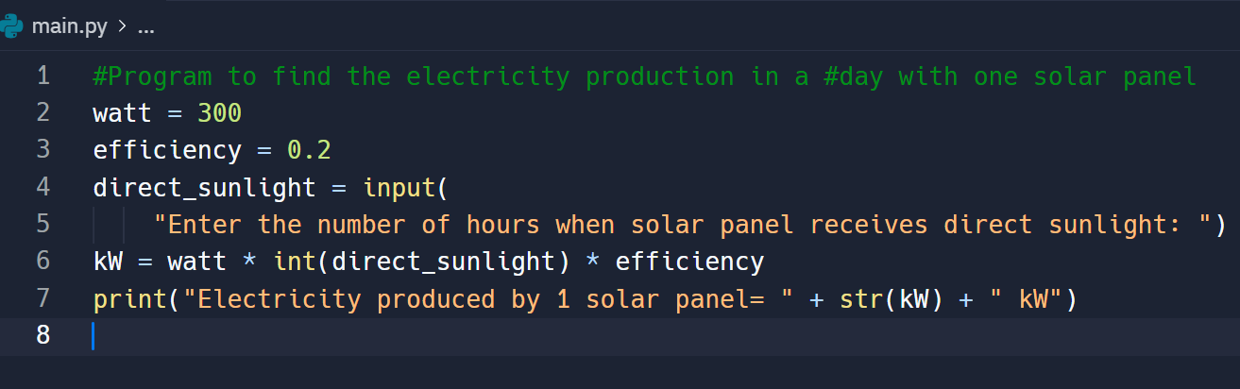
Additional Activity- 01
https://colab.research.google.com/drive/14kSF__uow49DFbwY0Ng7UPUocxSdu3Sc?usp=sharing
Notes:
Teacher Reference:
Explain the code in colab
Additional task: Take user input using input() function and ask the user to enter the hours of direct sunlight.
Ask Students: What if there are 10 such solar panels?

Slide 18
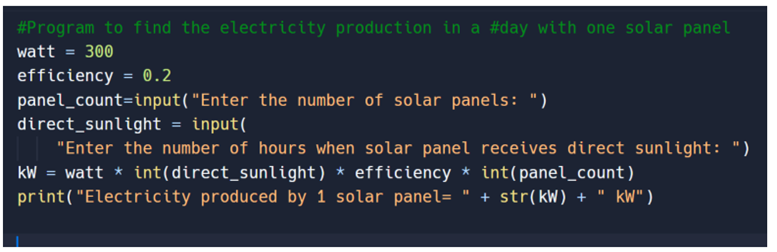
Additional Activity- 02
If 10 such solar panels were deployed, how much power would be produced?
https://colab.research.google.com/drive/14kSF__uow49DFbwY0Ng7UPUocxSdu3Sc?usp=sharing
Notes:
Teacher Reference:
Explain the code in colab
Students can change the number of solar panels, and can calculate wattage for a month or a year,

Slide 19
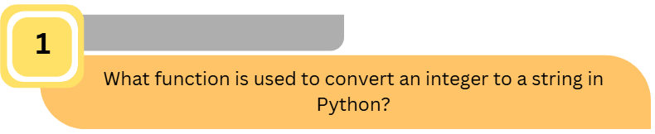
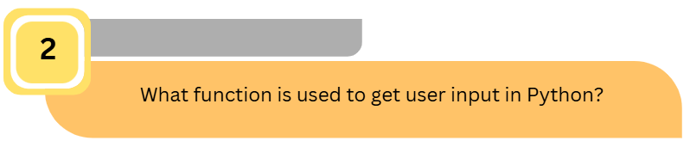
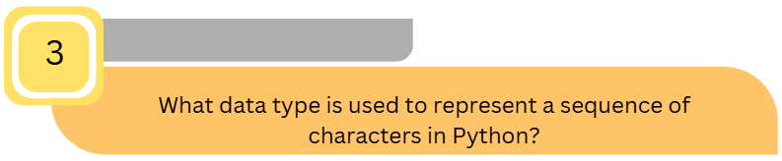
QUIZ
Notes:
str()
Input()
String

Slide 20
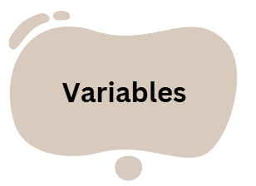
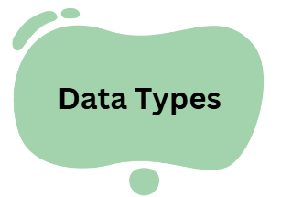
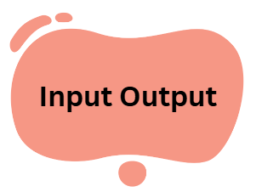
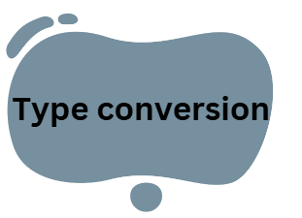
SUMMARY

Slide 21
Homework Assignment
Find the power production according to different seasons by number of solar panels.
Season: For summer, direct sunlight is for 5-6 hours
Daily Output (kWh) = 300 W x 5 hours x 0.2 x No. of panels
For winter, direct sunlight is for 2-3 hours
Daily Output (kWh) = 300 W x 2 hours x 0.2 x No. of panels
Notes:
Teacher Reference:
Link: https://colab.research.google.com/drive/1xcMLD8nIEOg1q79pcPd5EqF-qPlvvyv_?usp=sharing

Slide 22
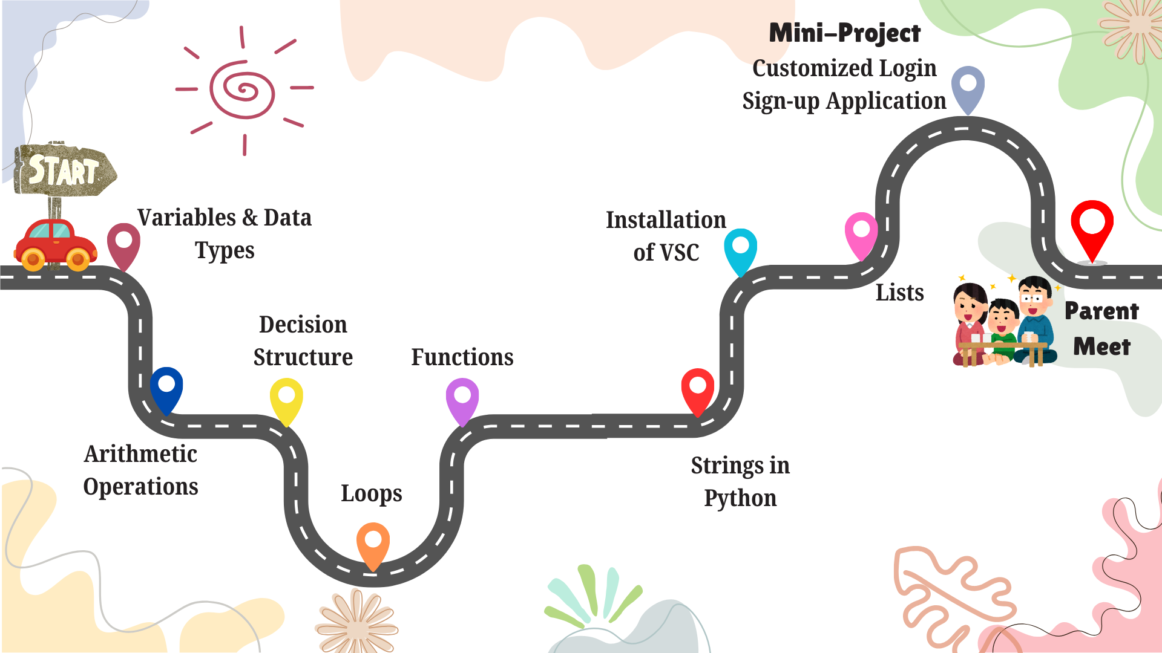

Slide 23





RATE & RELATE
ShowTime
Take a moment to rate today’s class after you leave. Your feedback is valuable!
Share your creativity with your family – they’ll love seeing what you've built!
HOMEWORK
Be Early
IMPORTANT!
“Consistency is key”:
10 minutes of coding daily can make you a pro!
Join a few minutes early for our next session to kick things off smoothly.

Slide 24
Thank You!

